Slide 1
The Theory of
Continental Drift
& Plate Tectonics
Mr. DeGeorge
January 2012
Earth Science

Slide 2
Part I. The Theory of Continental Drift

Slide 3
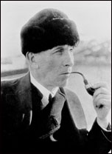
Alfred Wegener (1912)
-Alfred Wegener developed the theory of continental drift
-He believed all the continents were at one time joined together
-These formed a supercontinent known as Pangaea

Slide 5
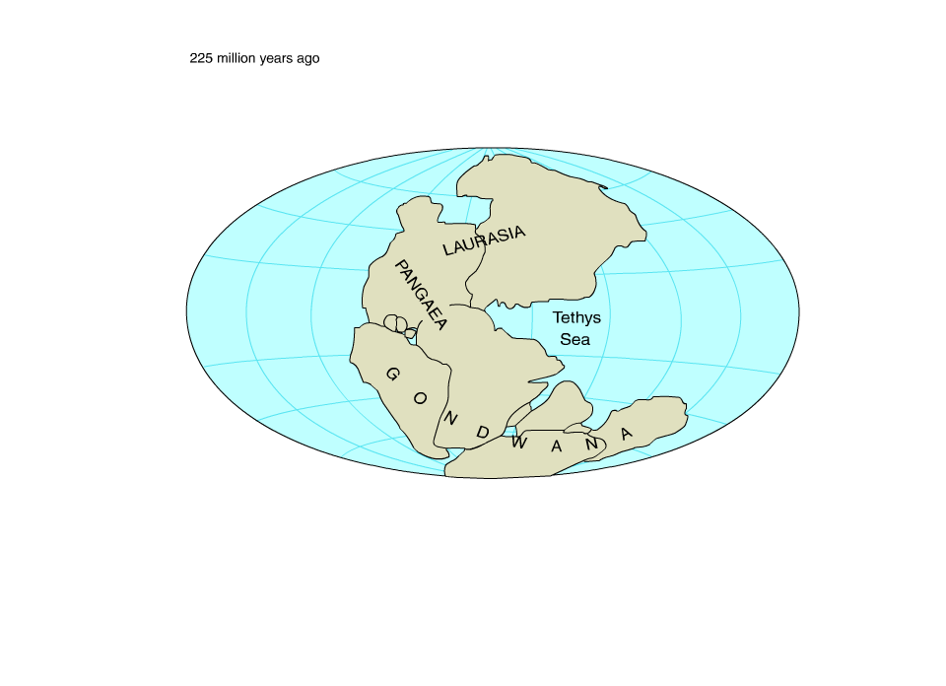

Slide 6
Wegener's Evidence for Continental Drift
1. Continents fit together like a puzzle
(Shown in short animation)
2. Fossil Correlation
3. Mountain Ranges and Rock layers line up
4. Glacier Evidence left behind
5. Paleomagnetism

Slide 7
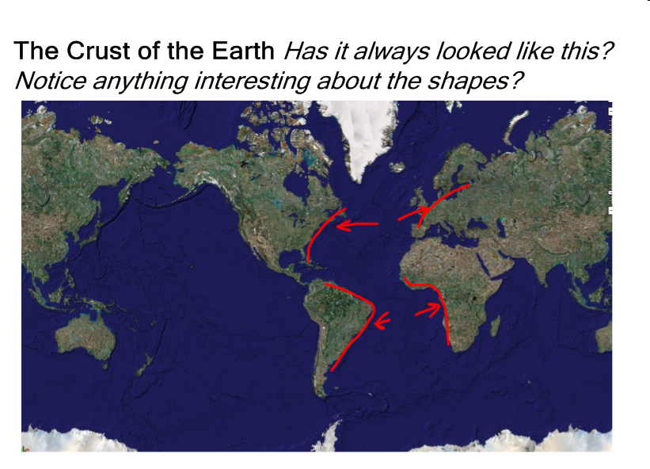
1. The continents fit together like a puzzle

Slide 8
2. Fossil Correlation
-The same fossil can be found on different continents.
-Land animals can’t swim!
-The shaded area represents the roaming patterns of the animals
-How did the fossils get from continent to continent?

Slide 10
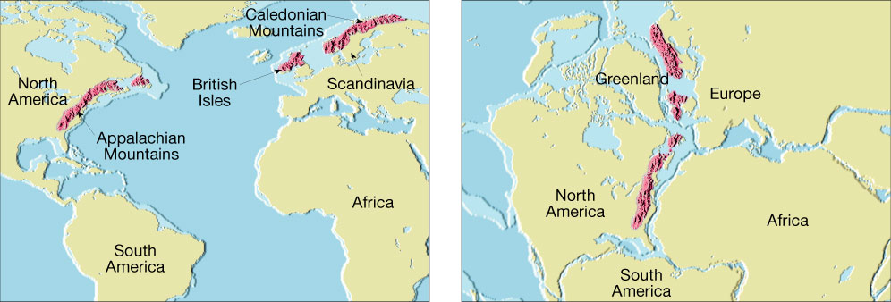
3. Mountain Ranges and Rock layers line up
When the continents fit together like a puzzle, mountains also line up.
Example: The Mountains in Norway align with the Appalachians

Slide 11
3. Mountain Ranges and Rock layers line up
-When the land matches up so does the layers of rock up and down
Think about how these layers can be found on separate continents!!!
Q: What does this suggest about their formation?

Slide 12
4. Glaciers
-Warm climates have evidence of glaciers which suggest the continent must have been moved from a different latitude.
-Imagine you’re in the Rainforest of the Congo and your hunting cougars and you see evidence of Glacial Till.
-Explain why there is glacial till in the middle of a rainforest.

Slide 13
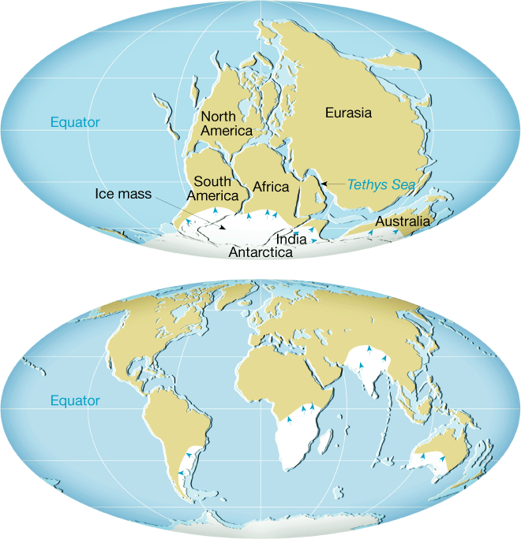
4. Glaciers Cont.
When Pangaea existed, Central Africa was over the South Pole
Glaciers were formed on top of the land.
Evidence of glaciers is still left behind today

Slide 14
Evidence: Glaciers Cont.

Slide 15
Should coal and oil be found in Alaska?
-Recall that coal and oil form in tropical environments
- Tell your neighbor why we find oil in Alaska today.

Slide 16
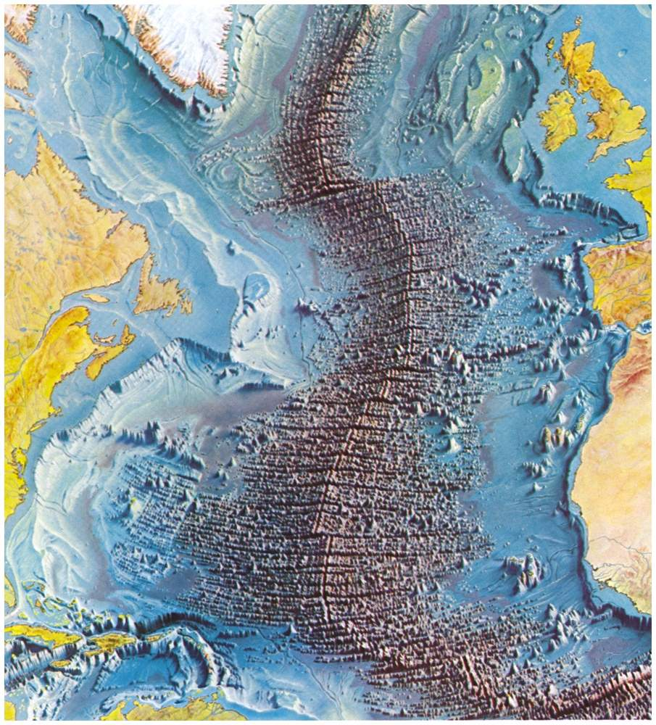
5. Paleomagnetism
-Sea-floor
Spreading
-Occurs at mid-
ocean ridges

Slide 17
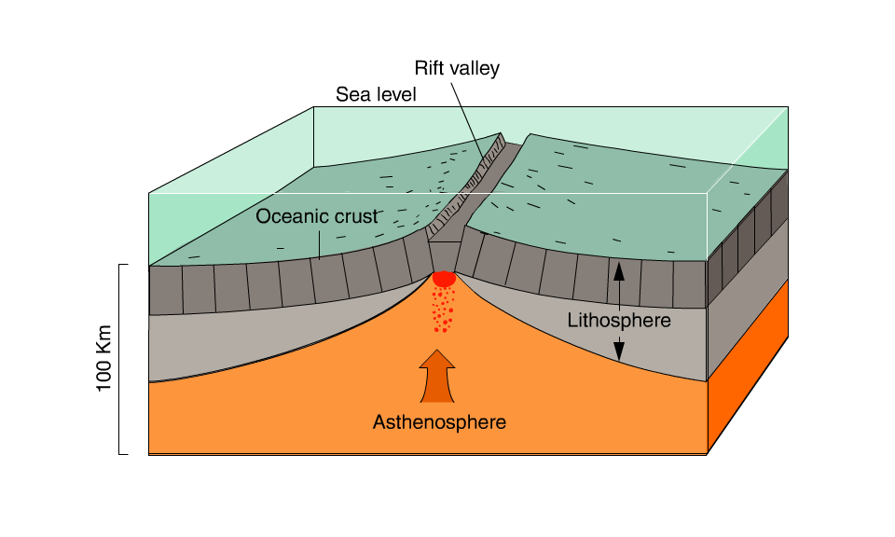
Evidence: Paleomagnetism

Slide 18
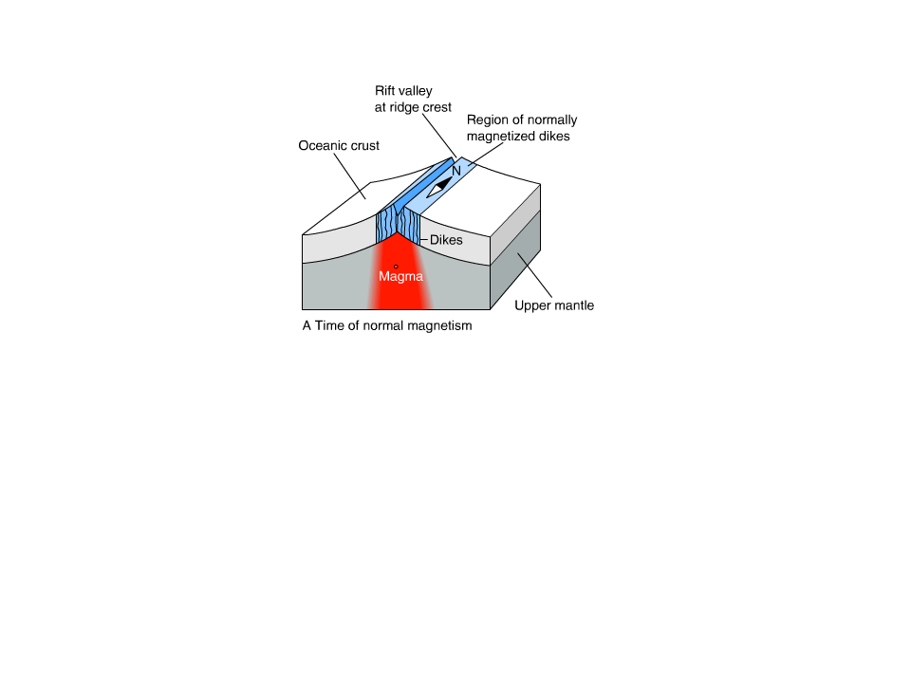
Evidence: Paleomagnetism
-Sometimes the North and South Pole switch changing magnetic alignment.
-When rocks form at the ocean floor the pattern changes back and forth
-This animation shows that as new crust is made there is a symmetrical pattern or rock formation with the same alignment

Slide 19
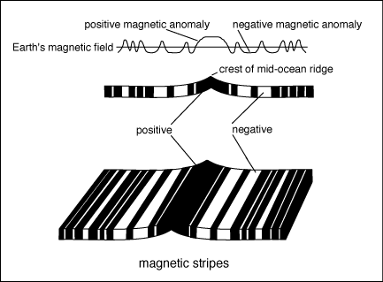
Testing the model….

Slide 20
Conclusion: Imagine you were Alfred Wegener in 1912 and you have to convince the National Science Foundation (NSA) of the Theory of Continental Drift. Write a speech OR make a visual representation to prove your point.

Slide 22
Part II: Convection in the Mantle
and
Crustal Deformation

Slide 23
Alfred Wegener was considered a fraud and a phony is the science world because he was missing one important detail in his work… What causes the continents to move?

Slide 24
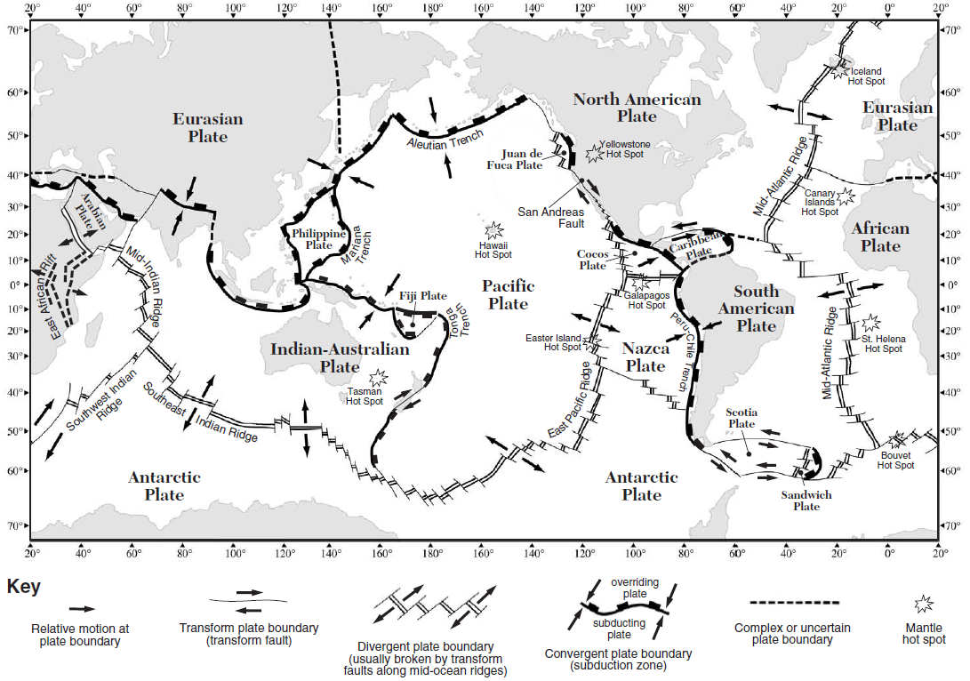
Here are those moving Tectonic Plates
******ESRT PAGE 5******

Slide 25
Another look at the plates…

Slide 26
Imagine Rice boiling, what path of motion is the rice moving in?
Boiling Water
It is moving in circles
Why does the rice move in circles?
The water/rice heats and rises then cools at the surface and sinks continuing the circle
*CHANGES IN DENSITY
-Hot Rises
-Cool Sinks

Slide 27
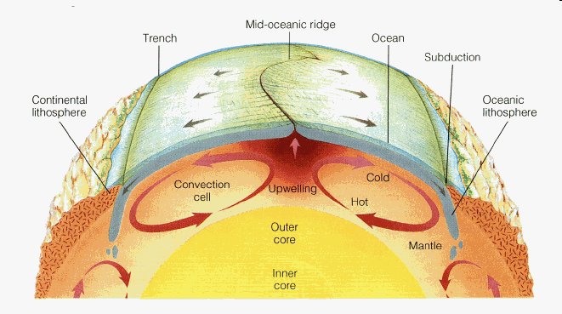
Convection Currents
Convection Currents are the movement of magma in the asthenosphere in circles. (like the rice)
They move around the floating tectonic plates above them

